Slide 1
Gradient Descent for Linear Regression (Simple and Multiple)
From:
DS100 UC Berkeley

Slide 2
Our goals for this lecture
Optimizing complex models – how do we select parameters when the loss function is “tricky”?
Identifying cases where straight calculus or geometric arguments won’t work
Introducing an alternative technique – gradient descent

Slide 3
Agenda
Optimization: where are we?
Minimizing an arbitrary 1D function
Gradient descent on a 1D model
Gradient descent on high-dimensional models
Batch, mini-batch, and stochastic gradient descent

Slide 4
Agenda
Optimization: where are we?
Minimizing an arbitrary 1D function
Gradient descent on a 1D model
Gradient descent on high-dimensional models
Batch, mini-batch, and stochastic gradient descent

Slide 5

What We’ve Done
Takeaways from the past lecture:
Choose a model
Choose a loss function
Optimize parameters – choose the values of that minimize the model’s loss
How have we optimized?
Use calculus to solve for
Take derivatives, set equal to 0, solve.

Slide 6
Where We’re Going
We made some big assumptions
assumed that the loss function was differentiable at all points and that the algebra was manageable
To design more complex models with different loss functions, we need a new optimization technique: gradient descent.
Big Idea: use an algorithm instead of solving for an exact answer

Slide 7
Our Roadmap
Big Idea: use an algorithm instead of solving for an exact answer
Structure for today’s lecture:
Use a simple example (some arbitrary function) to build the intuition for our algorithm
Apply the algorithm to a simple model to see it in action
Formalize the algorithm to be applied to any model
Remember our goal: find the parameters that minimize the model’s loss
Let’s do it.

Slide 8
Minimizing an arbitrary 1D function
Optimization: where are we?
Minimizing an arbitrary 1D function
Gradient descent on a 1D model
Gradient descent on high-dimensional models
Batch, mini-batch, and stochastic gradient descent

Slide 9
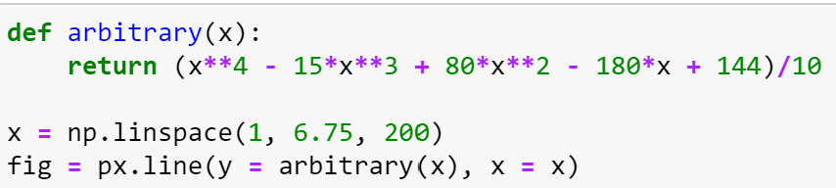
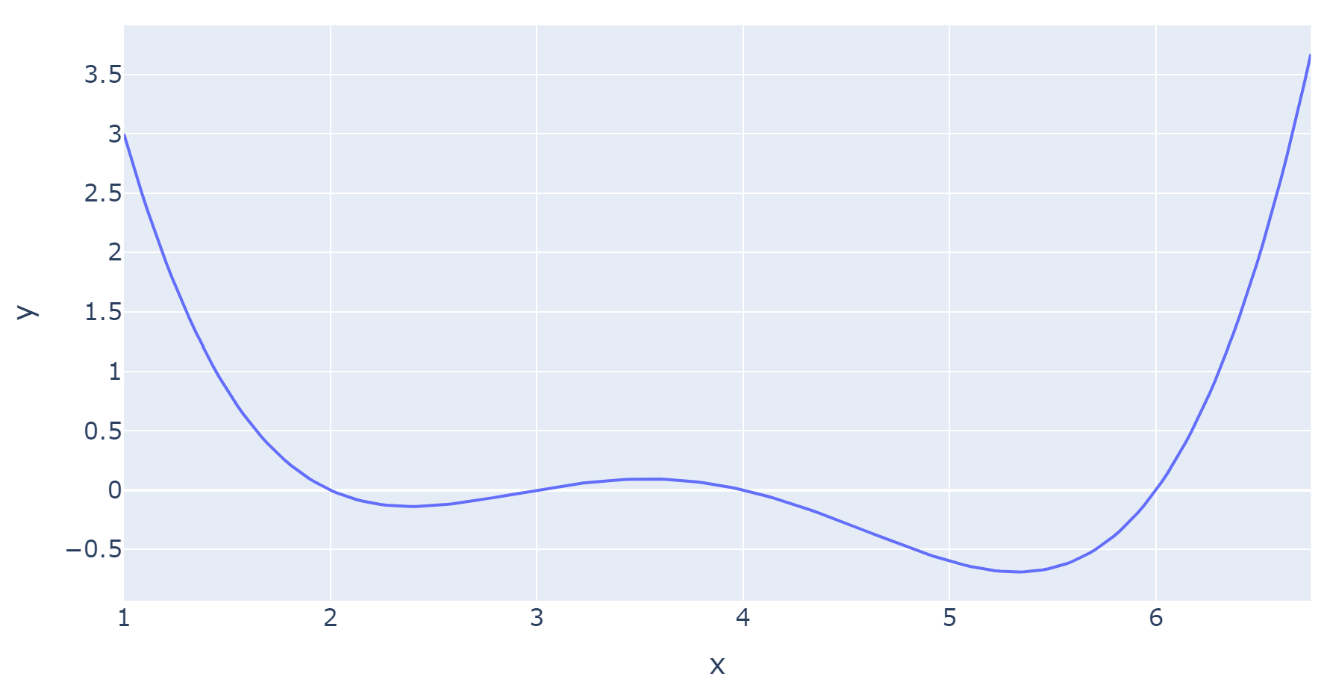
An Arbitrary Function

Slide 10
An Arbitrary Function
Our goal is to find the value of x that minimizes our function.
Minimum of function
Minimizing value of x

Slide 11
Finding the Minimum
We could start with a random guess.

Slide 12
Finding the Minimum
Where do we go next? We “step” downhill.
Follow the slope of the line down to the minimum.

Slide 13
Finding the Minimum
We arrive closer to the minimum.
Positive slope → step to the left

Slide 14
Finding the Minimum
Do this again: follow the slope downwards towards the minimum
Positive slope → step to the left

Slide 15
Finding the Minimum
Do this again: follow the slope downwards towards the minimum
Positive slope → step to the left

Slide 16
Finding the Minimum
What if we had started elsewhere?

Slide 17
Finding the Minimum
What if we had started elsewhere?

Slide 18
Finding the Minimum
What if we had started elsewhere?
Negative slope → step to the right

Slide 19
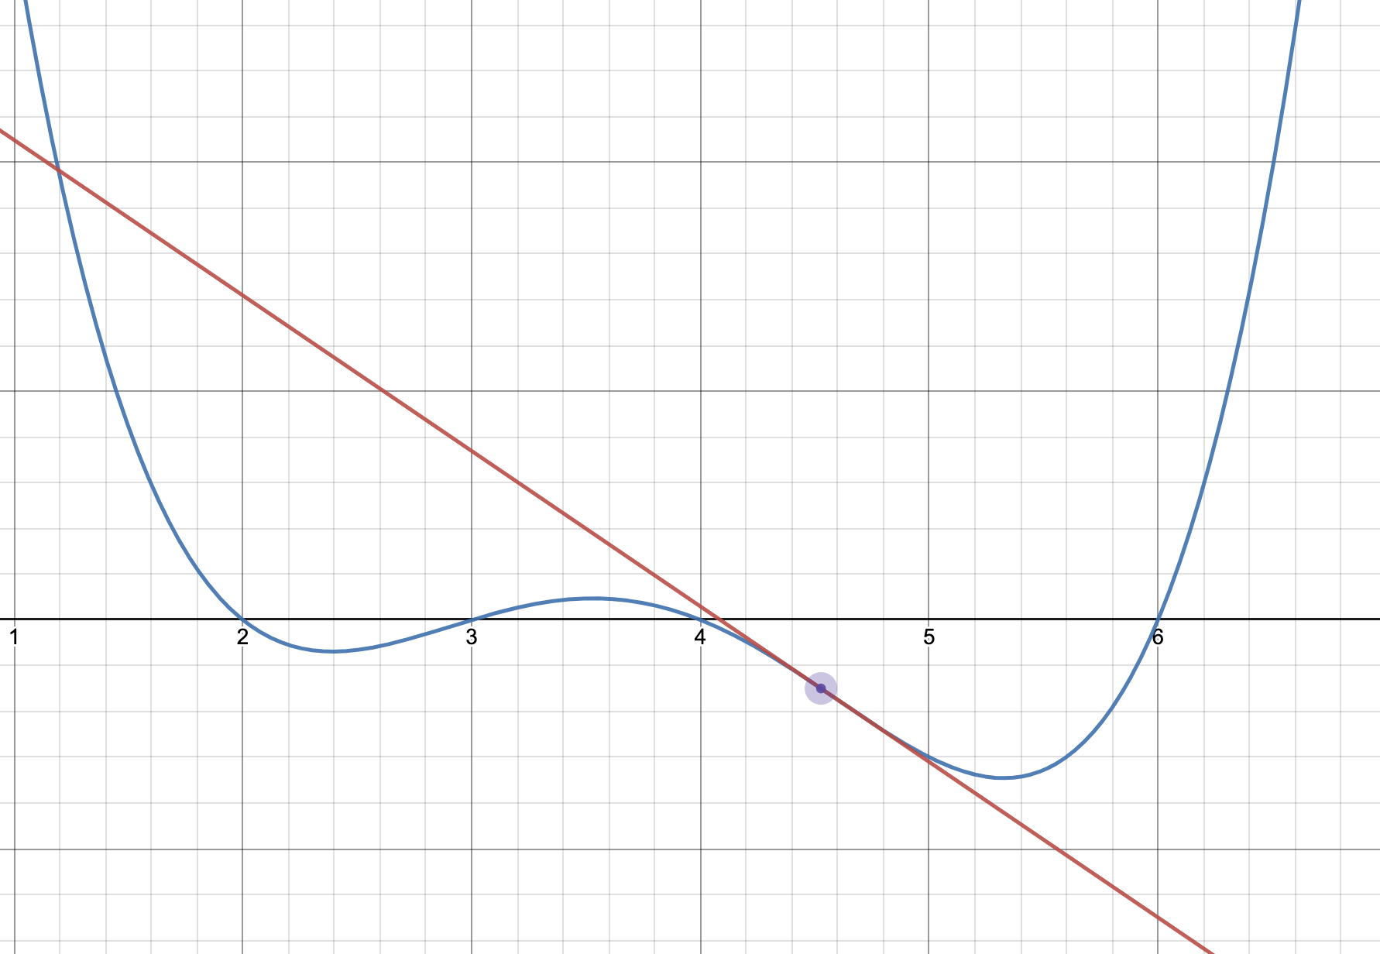
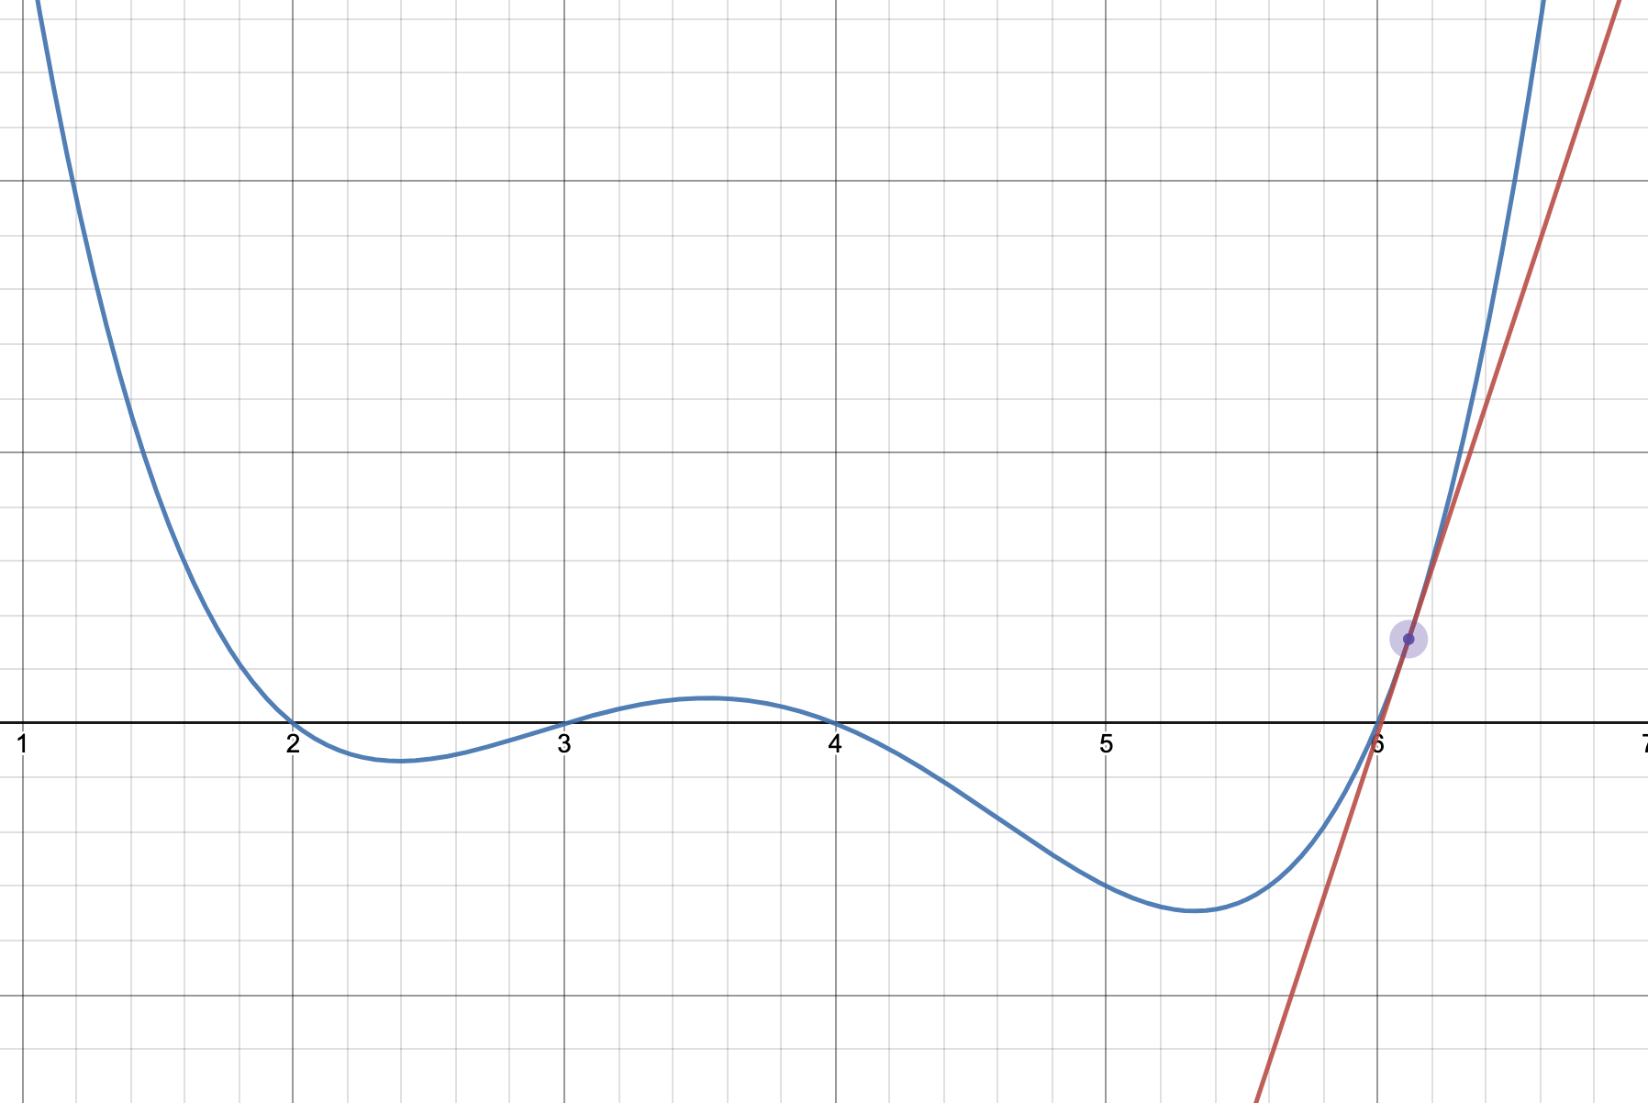
Slopes Tell Us Where to Go
Negative slope → step to the right Move in the positive direction
Positive slope → step to the left
Move in the negative direction
The derivative of the function at each point tells us the direction of our next guess.
Demo link: https://www.desmos.com/calculator/twpnylu4lr

Slide 20
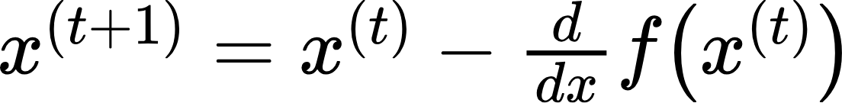
Slopes Tell Us Where to Go
The derivative of the function at each point tells us the direction of our next guess.
Negative slope → step to the right Move x in the positive direction
Positive slope → step to the left
Move x in the negative direction
Our first attempt at making an algorithm: step in the opposite direction to the slope
Our next guess for the minimizing x
…starts at the previous guess
…and moves opposite to the slope

Slide 21
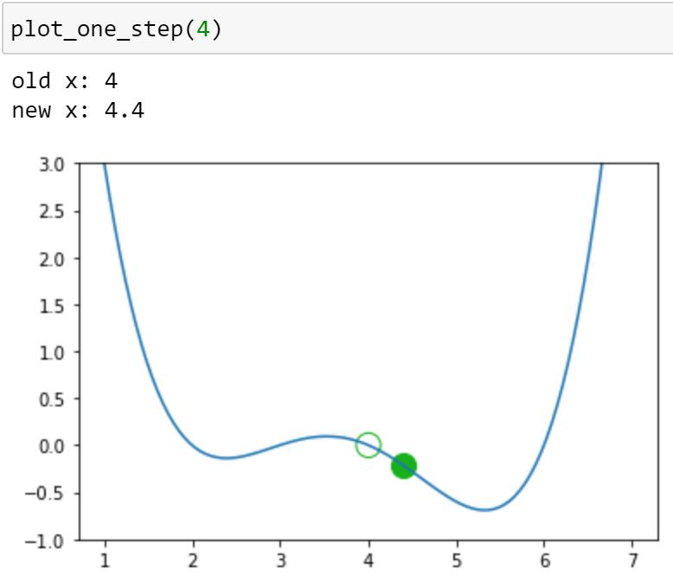
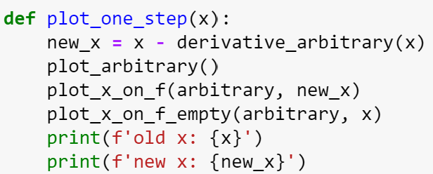
Algorithm Attempt #1

Slide 22
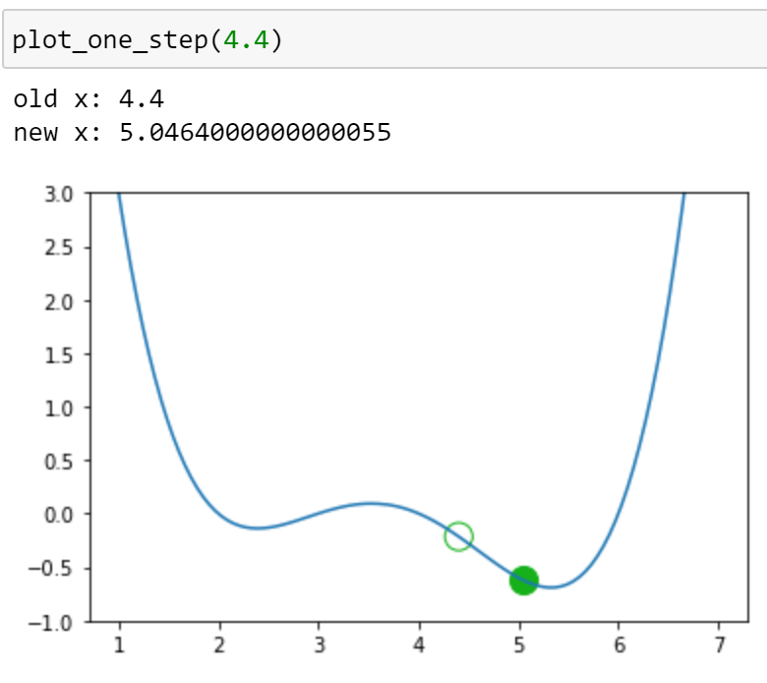
Algorithm Attempt #1

Slide 23
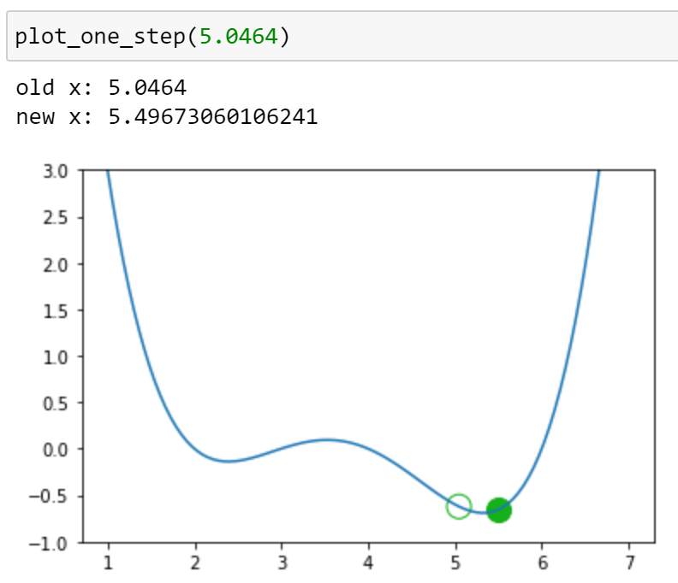
Algorithm Attempt #1

Slide 24
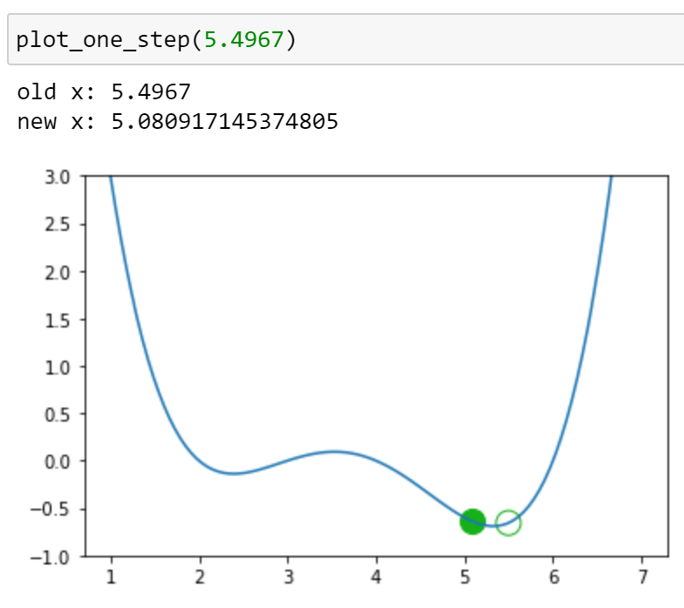
Algorithm Attempt #1

Slide 25
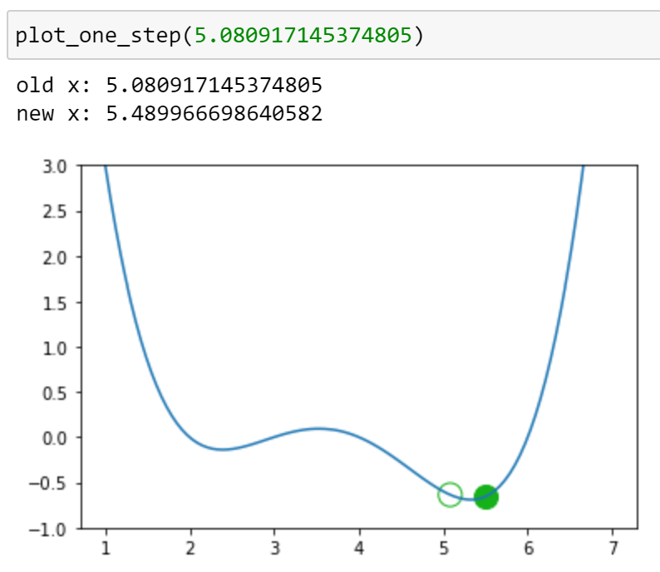
Algorithm Attempt #1

Slide 26
Algorithm Attempt #1
We appear to be bouncing back and forth. Turns out we are stuck!
Any suggestions for how we can avoid this issue?

Slide 27

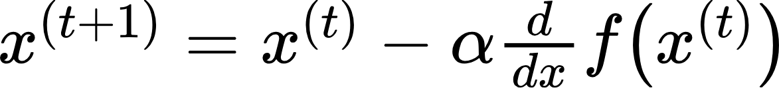

Introducing a Learning Rate
Problem: each step is too big, so we overshoot the minimizing x
Solution: decrease the size of each step
Updated algorithm: represents a learning rate that we choose. It controls the size of each step.
Our next guess for the minimizing x
…starts at the previous guess
…and moves opposite to the slope
Let’s try

Slide 28
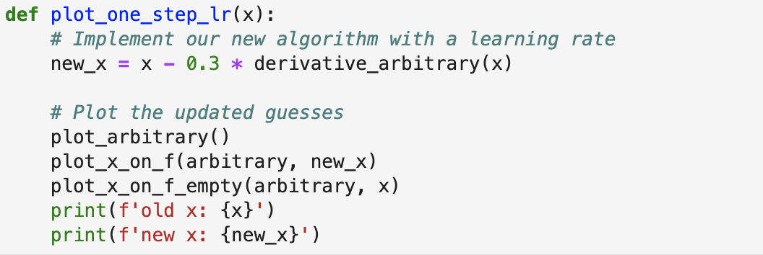
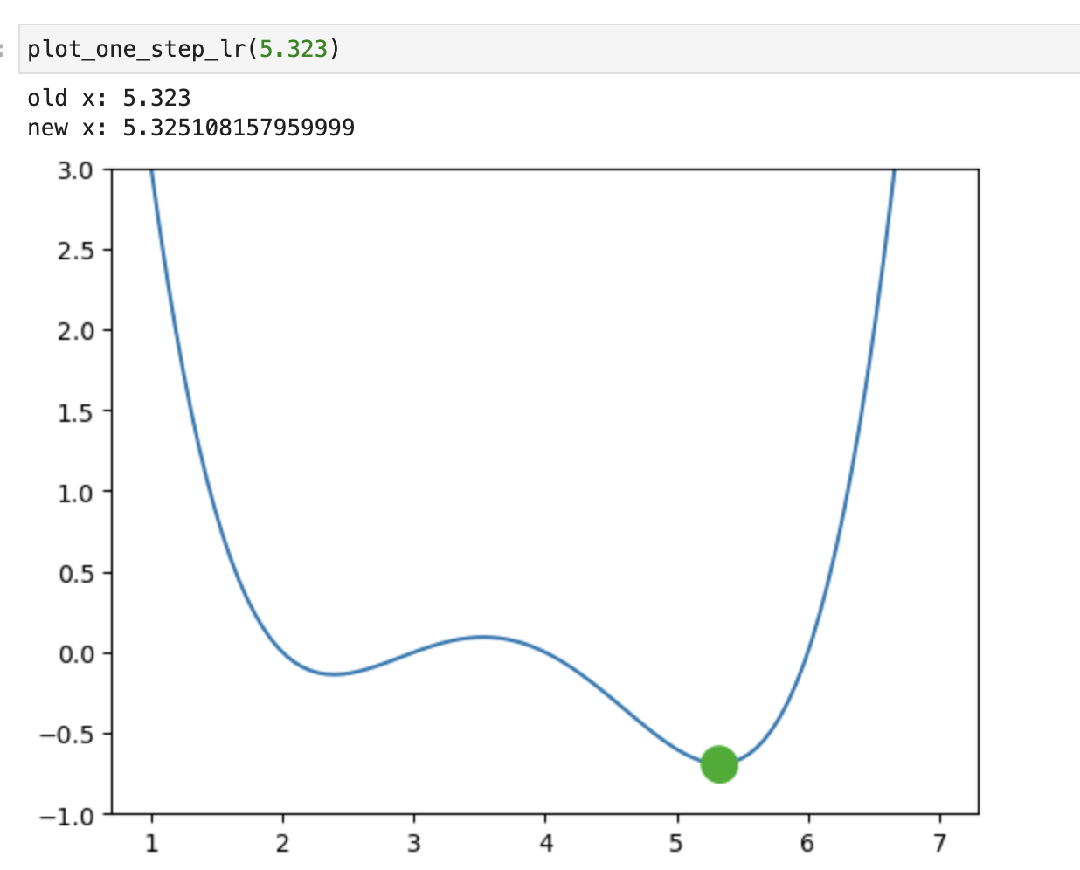
Algorithm Attempt #2
When do we stop updating?
Some options:
After a fixed number of updates
Subsequent update doesn’t change “much”
Convergence: GD settles on a solution and stops updating significantly (or at all)

Slide 29
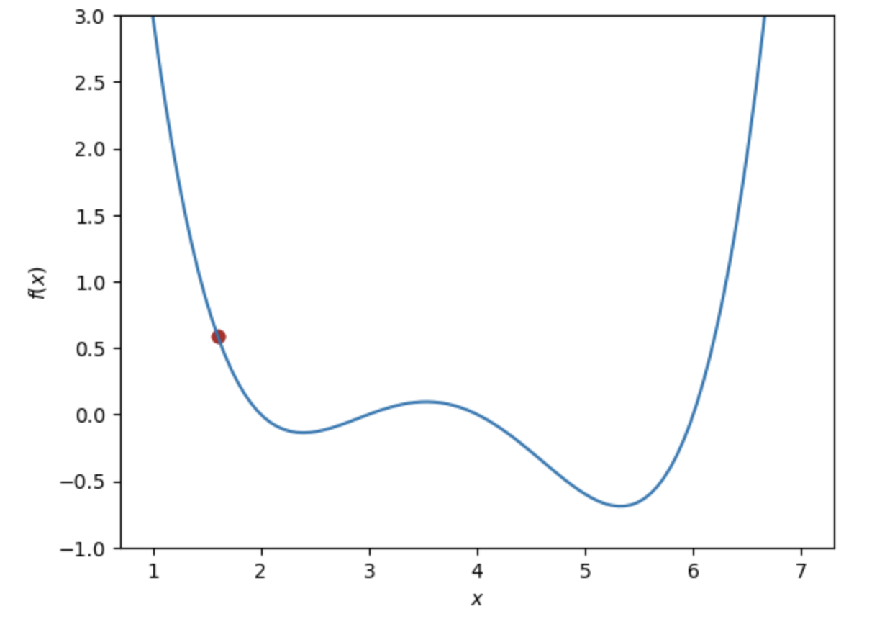
Convexity
What if our initial guess had been elsewhere?
Starting guess near local minimum

Slide 30
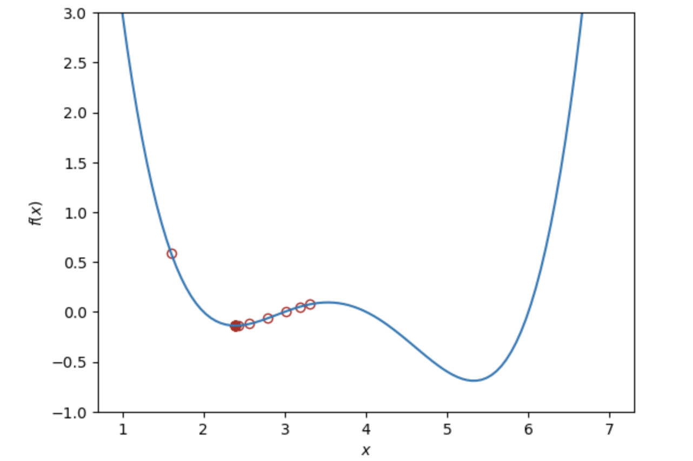
Convexity
What if our initial guess had been elsewhere?
The algorithm may have gotten “stuck” in a local minimum.
Starting guess near local minimum
Final guess fails to find the true global minimum

Slide 31
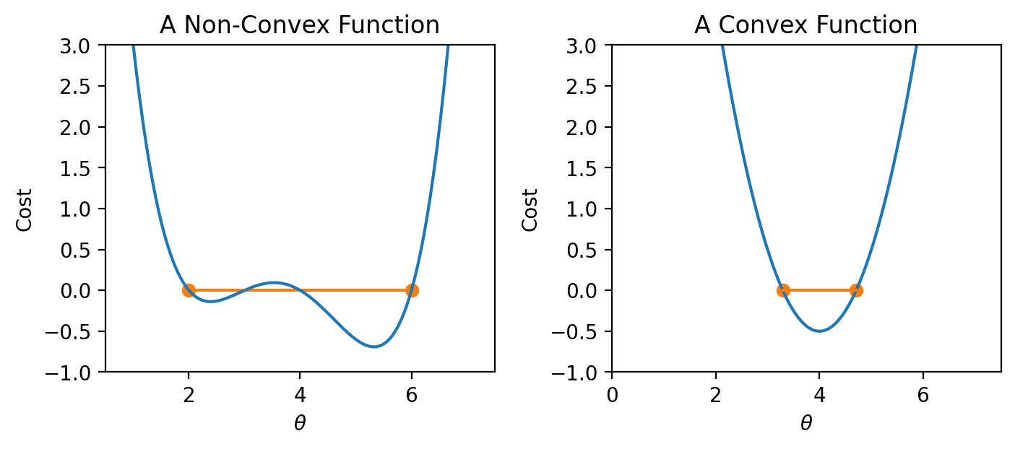
Convexity
For a convex function, any local minimum is a global minimum – we avoid the situation where the algorithm converges on some critical point that is not the minimum of the function.
Our arbitrary function is non-convex
Algorithm is only guaranteed to converge (given enough iterations and an appropriate step size) for convex functions.
if I draw a line between any two points on the curve, all values on the curve must be at or below the line.

Slide 32
Agenda
Optimization: where are we?
Minimizing an arbitrary 1D function
Gradient descent on a 1D model
Gradient descent on high-dimensional models
Batch, mini-batch, and stochastic gradient descent

Slide 33
From Arbitrary Functions to Loss Functions
In a modeling context, we aim to minimize a loss function by choosing the minimizing model parameters.
Terminology clarification:
In past lectures, we have used “loss” to refer to the error incurred on a single datapoint
In applications, we usually care more about the average error across all datapoints
Going forward, we will take the “model’s loss” to mean the model’s average error across the dataset. This is sometimes also known as the empirical risk, cost function, or objective function.

Slide 34
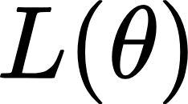
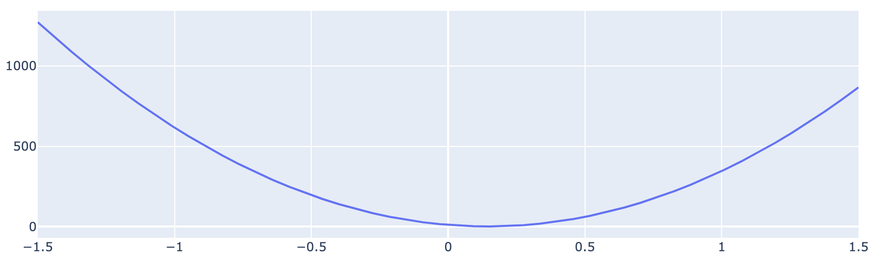
From Arbitrary Functions to Loss Functions
In a modeling context, we aim to minimize a loss function by choosing the minimizing model parameters.
Goal: choose the value of that minimizes , the model’s loss on the dataset
Our new framework:
Compute the model’s loss for this choice of parameter
Test several values of the parameter

Slide 35
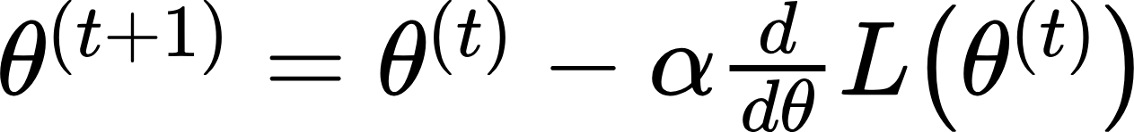
From Arbitrary Functions to Loss Functions
Goal: choose the value of that minimizes , the model’s loss on the dataset
The 1D gradient descent algorithm:
Take our algorithm from before, replace x with and f with L.

Slide 36
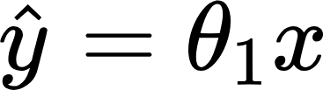
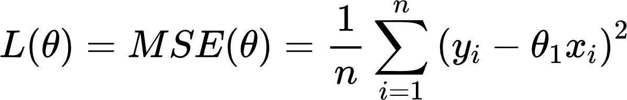
Gradient Descent on the tips Dataset
We want to predict the tip (y) given the price of a meal (x). To do this:
Choose a model:
Choose a loss function:

Slide 37
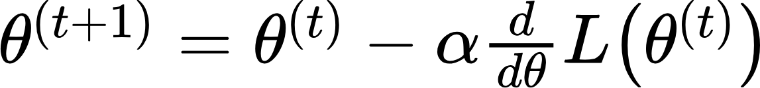
Gradient Descent on the tips Dataset
We want to predict the tip (y) given the price of a meal (x). To do this:
Choose a model:
Choose a loss function:
Optimize the model parameter – apply gradient descent

Slide 38
Gradient Descent on the tips Dataset
Optimize the model parameter – apply gradient descent
Our loss function

Slide 39
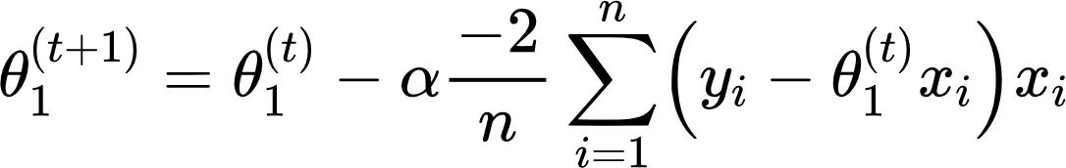

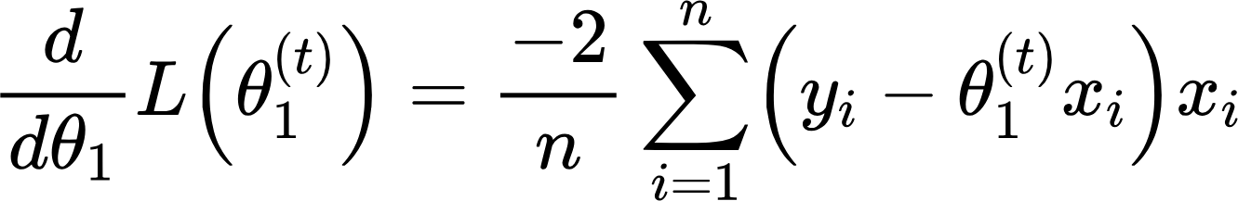
Gradient Descent on the tips Dataset
Optimize the model parameter – apply gradient descent
Our loss function
The gradient descent update rule
Take the derivative wrt

Slide 40
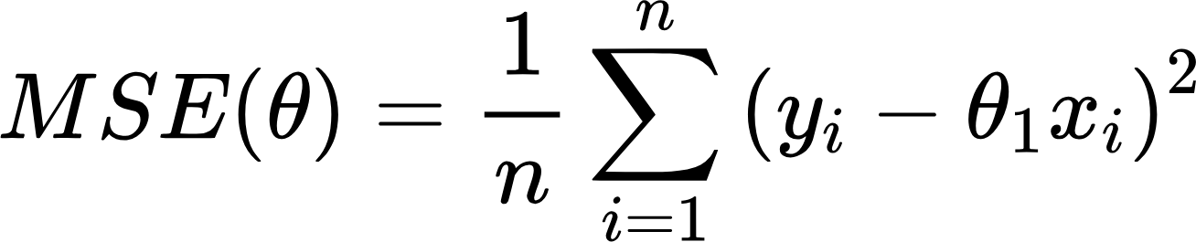
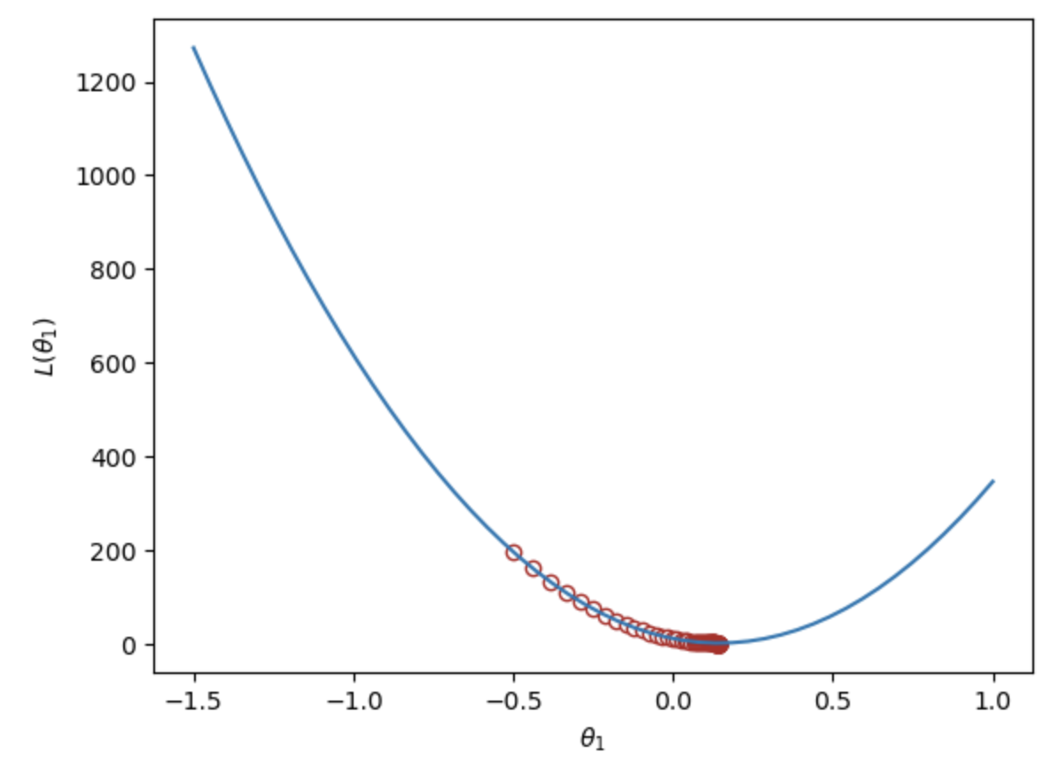
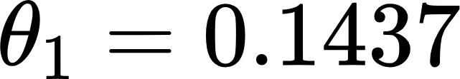
Gradient Descent on the tips Dataset
Loss function:
GD update rule:
MSE is minimized when we set

Slide 41
MSE is Convex!
When we visualized the MSE loss on the tips data, there was a single global minimum
This is one reason why the MSE is a popular choice of loss function: it behaves “nicely” for optimization

Slide 42
Agenda
Optimization: where are we?
Minimizing an arbitrary 1D function
Gradient descent on a 1D model
Gradient descent on high-dimensional models
Batch, mini-batch, and stochastic gradient descent

Slide 43
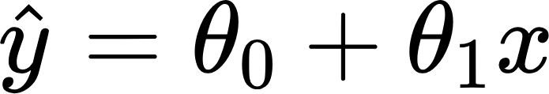
Models in 2D or Higher
Usually, models will have more than one parameter that needs to be optimized.
Simple linear regression:
Multiple linear regression:
Idea: expand gradient descent so we can update our guesses for all model parameters, all in one go

Slide 44
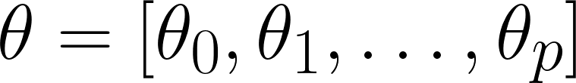

Multiple Linear Regression
Define the multiple linear regression model:
Parameters are .
A. no
B. yes
C. maybe
Is this linear in ?

Slide 45
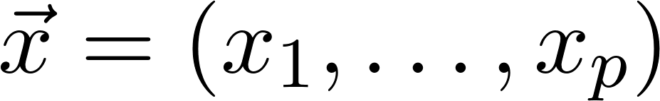

Multiple Linear Regression
Define the multiple linear regression model:
Parameters are
single input (p features)
single prediction

Slide 46


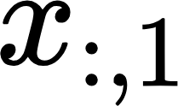
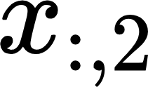
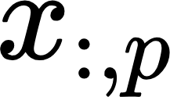
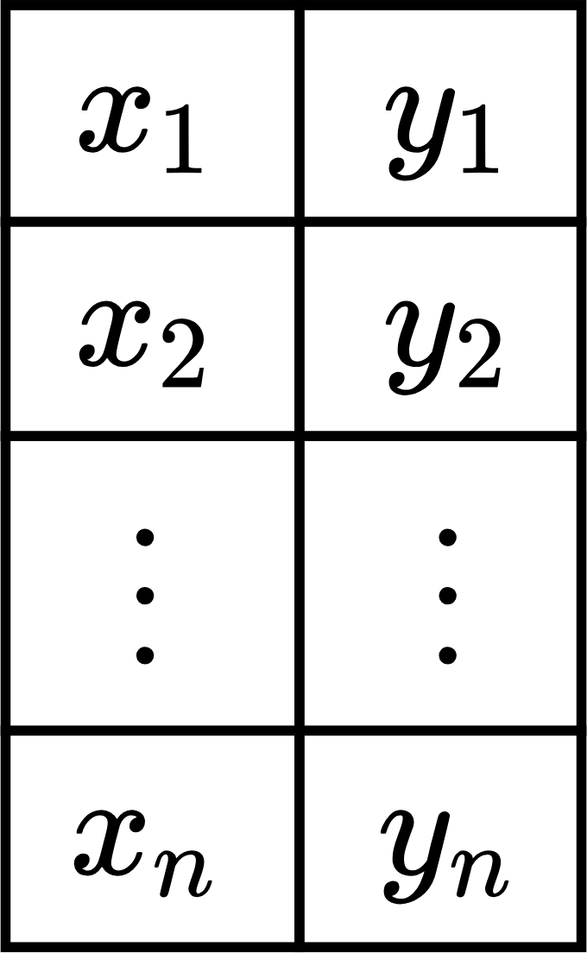
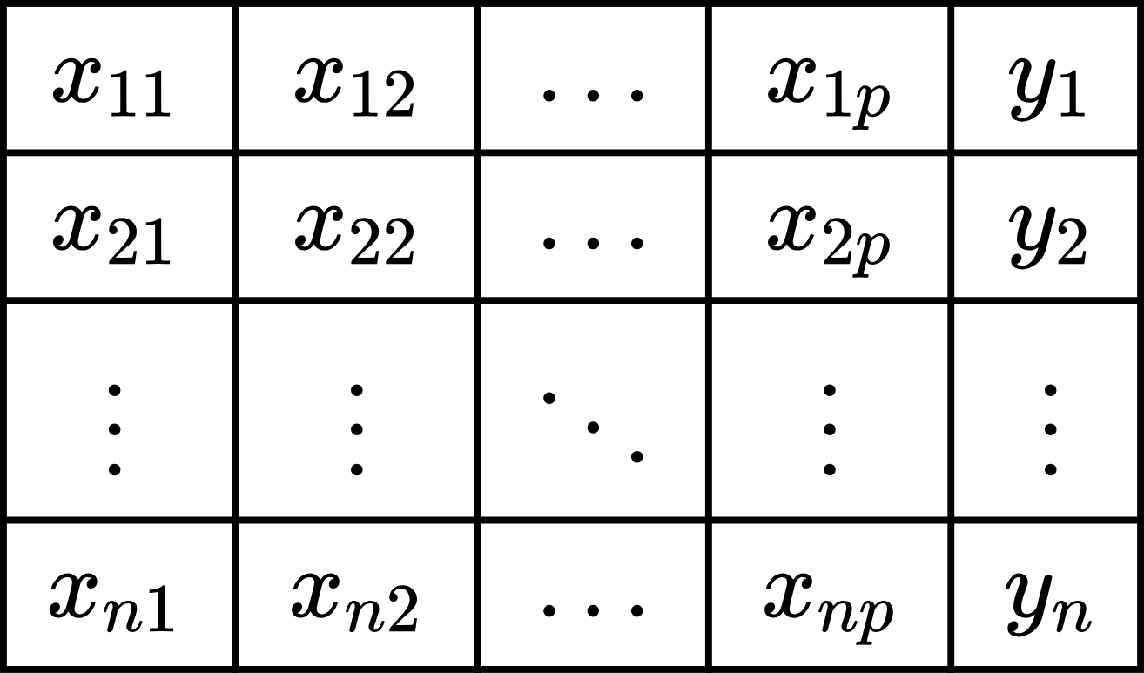
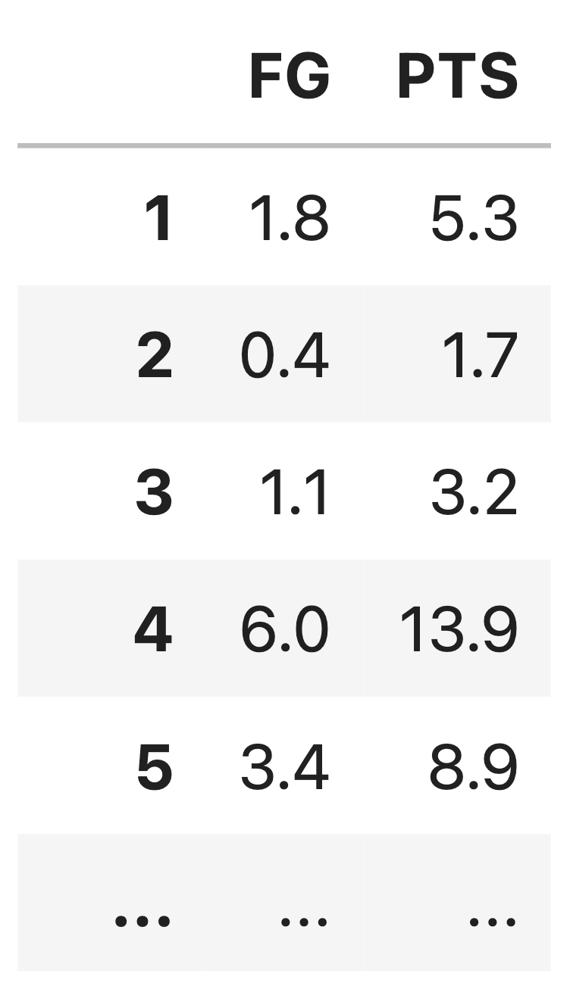
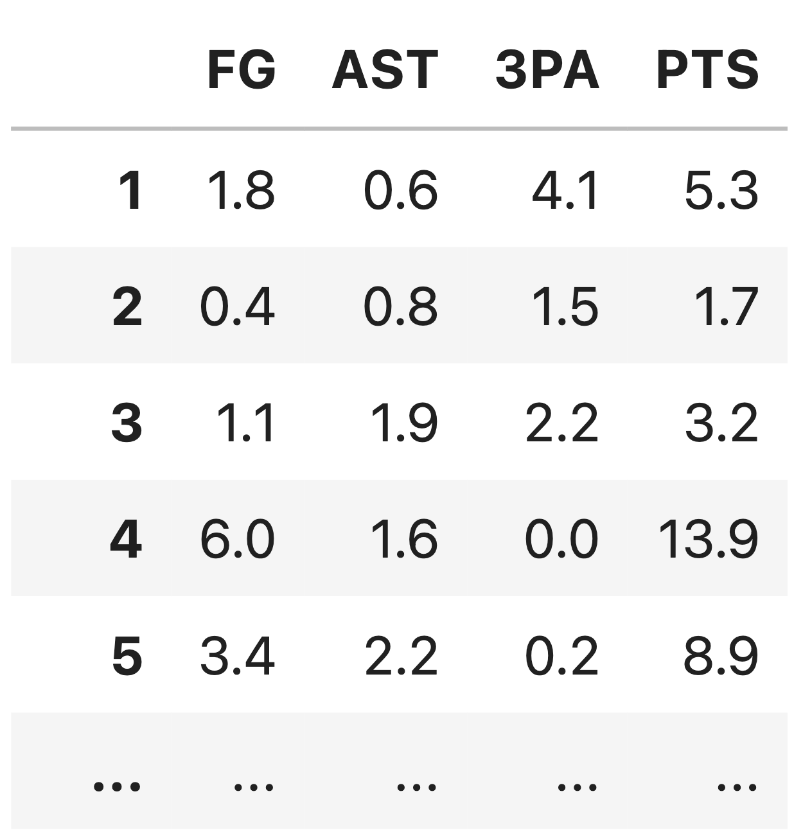
From SLR to Multiple linear regression

Slide 47
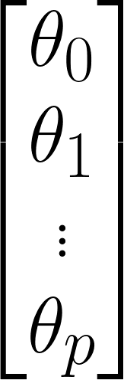
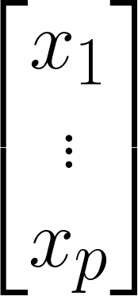

Multiple Linear Regression
Define the multiple linear regression model:
.
single prediction
single observation
(p features)

Slide 48
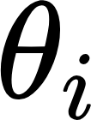
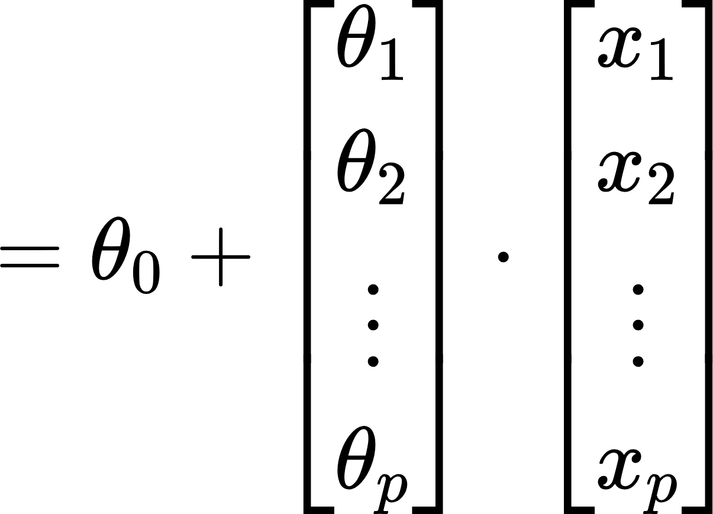
Vector Notation
We want to collect all the ‘s into a single vector.
This part looks a little like a dot product…
😤What about this one???

Slide 49
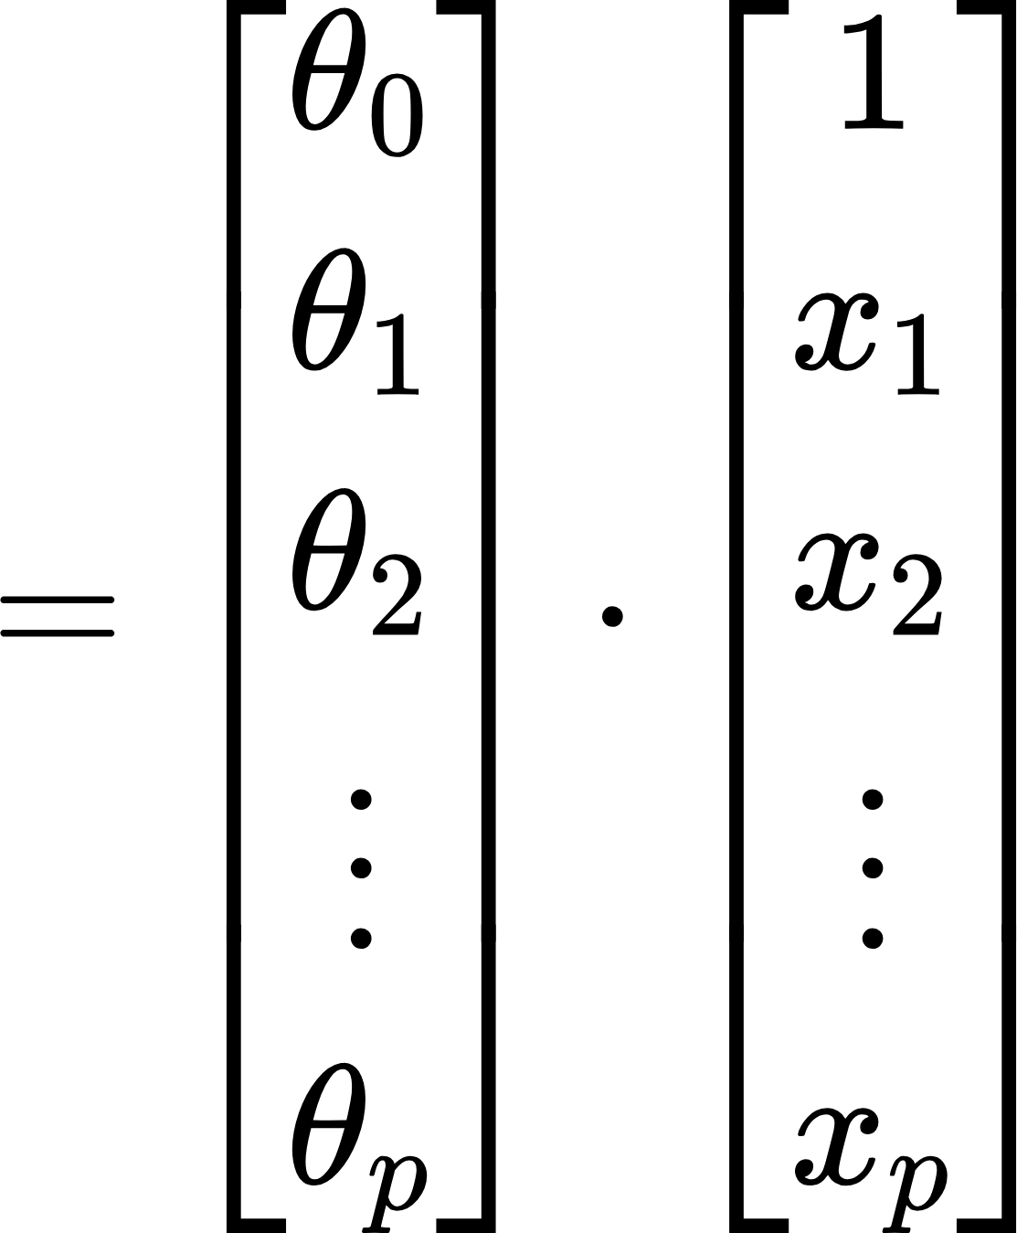
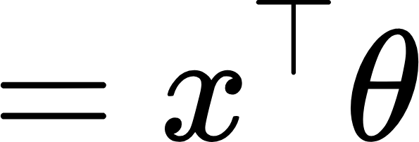
Vector Notation
We want to collect all the ‘s into a single vector.
bias term, intercept term

Slide 50
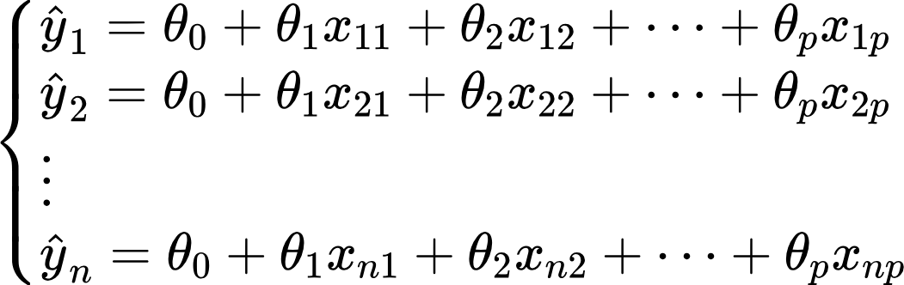
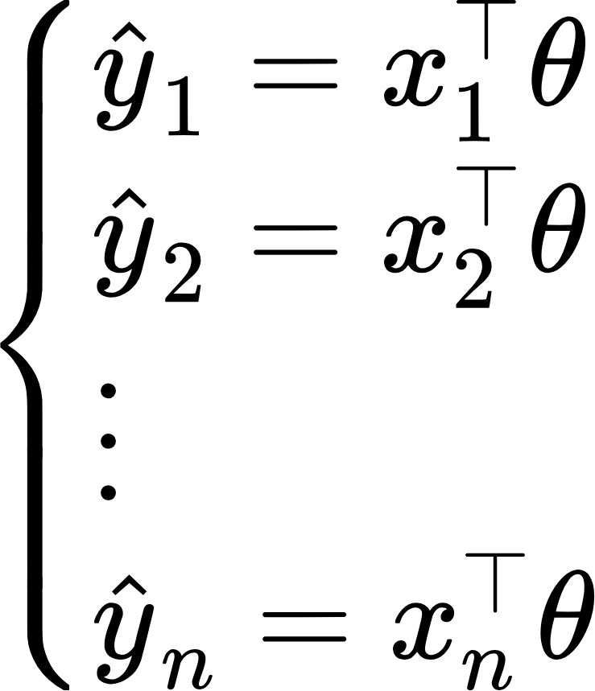
Matrix Notation
where is datapoint/observation 1
where is datapoint/observation 2
where is datapoint/observation n

Slide 51
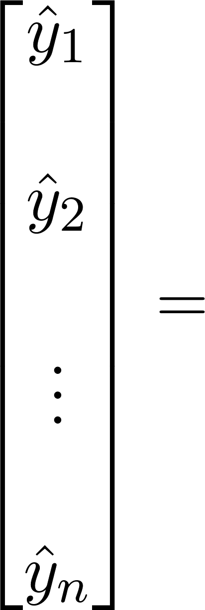
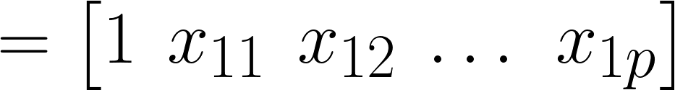
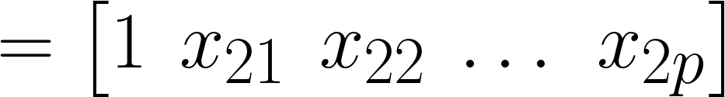
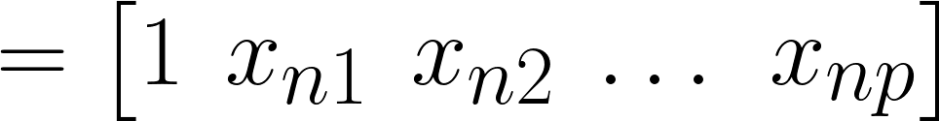
Matrix Notation
…
n row vectors, each with dimension (p+1)
Vectorize predictions and parameters to encapsulate all n equations into a single matrix equation.

Slide 52


Matrix Notation
…
Design matrix with dimensions n x (p + 1)

Slide 53






The Multiple Linear Regression Model Using Matrix Notation
We can express our linear model on our entire dataset as follows:
Note that our true output is also a vector:
Prediction vector
Design matrix
Parameter vector

Slide 54



Mean Squared Error with L2 Norms
We can rewrite mean squared error as a squared L2 norm:
With our linear model :

Slide 55
Back to GD

Slide 56





Models in 2D or Higher
With multiple parameters to optimize, we consider a loss surface
What is the model’s loss for a particular combination of possible parameter values?
A bird’s eye view from above:

Slide 57


The Gradient Vector
As before, the derivative of the loss function tells us the best way towards the minimum value
On a 2D (or higher) surface, the best way to go down (gradient) is described by a vector
For the vector of parameter values
Take the partial derivative of loss with respect to each parameter

Slide 58



A Math Aside: Partial Derivatives
For an equation with multiple variables, we take a partial derivative by differentiating with respect to just one variable at a time.
Intuitively: how does the function change if we vary one variable, while holding the others constant?
Take the partial derivative wrt x: treat y as a constant
Take the partial derivative wrt y: treat x as a constant
This symbol means “partial derivative”

Slide 59




The Gradient Vector
For the vector of parameter values
Take the partial derivative of loss with respect to each parameter: ,
The gradient vector is
always points in the downhill direction of the surface.

Slide 60


Gradient Descent in Multiple Dimensions
Recall our 1D update rule:
Now, for models with multiple parameters, we work in terms of vectors:
Written in a more compact form:

Slide 61

Gradient Descent Update Rule
Gradient descent algorithm: nudge θ in negative gradient direction until θ converges.
For a model with multiple parameters:
θ: Model weights L: loss function
⍺: Learning rate (ours is constant; other techniques have ⍺ decrease over time)
gradient of the loss function evaluated at current θ
Next value for θ
61

Slide 62
Agenda
Optimization: where are we?
Minimizing an arbitrary 1D function
Gradient descent on a 1D model
Gradient descent on high-dimensional models
Batch, mini-batch, and stochastic gradient descent

Slide 63
Batch Gradient Descent
We have just derived batch gradient descent.
We used our entire dataset (as one big batch) to compute gradients
Recall the derivative of MSE for our 1D model – involves working with all n datapoints
Using all datapoints is often impractical when our dataset is large.
Computing each gradient will take a long time; gradient descent will converge slowly because each individual update is slow.

Slide 64
Mini-batch Gradient Descent
An alternative: use only a subset of the full dataset at each update.
Estimate the true gradient of the loss surface using just this subset of the data.
Batch size: the number of datapoints to use in each subset
In mini-batch GD:
Compute the gradient on the first x% of the data. Update the parameter guesses.
Compute the gradient on the next x% of the data. Update the parameter guesses.
…
Compute the gradient on the last x% of the data. Update the parameter guesses.
Training Epoch

Slide 65
Mini-batch Gradient Descent
In mini-batch GD:
Compute the gradient on the first x% of the data. Update the parameter guesses.
Compute the gradient on the next x% of the data. Update the parameter guesses.
…
Compute the gradient on the last x% of the data. Update the parameter guesses.
Training Epoch
In a single training epoch, we use every datapoint in the data once.
We then perform several training epochs until we are satisfied.

Slide 66
Stochastic Gradient Descent
In the most extreme case, we may perform gradient descent with a batch size of just one datapoint – this is called stochastic gradient descent.
Works surprisingly well in practice! Averaging across several epochs gives a similar result as directly computing the true gradient on all the data.
In stochastic GD:
Compute the gradient on the first datapoint. Update the parameter guesses.
Compute the gradient on the next datapoint. Update the parameter guesses.
…
Compute the gradient on the last datapoint. Update the parameter guesses.
Training Epoch

Slide 67


Comparing GD Techniques
Batch gradient descent:
Computes the true gradient
Always descends towards the true minimum of loss
Mini-batch/stochastic gradient descent:
Approximates the true gradient
May not descend towards the true minimum with each update

